Slide 1
Data Analytics Final Project
By Chase Rawson

Slide 2
Definitions
According to Investopedia, “Data analytics is the science of analyzing raw data to make conclusions about that information.” (Frankenfield, 2022)
There are different ways data analytics can be performed, such as descriptive (What happened?), diagnostic (Why it happened?), predictive (What will happen?), and perspective analytics (What’s next?).
Meanwhile, Data analysis is, “the process of systematically applying statistical and/or logical techniques to describe and illustrate, condense and recap, and evaluate data.” (“Responsible Conduct in Data Management”, n.d.)
Notes:
- Data analytics helps business perform more efficiently by utilizing evidence-based decisions.
- Data analysis is figuring out what the data is trying to tell us.

Slide 3
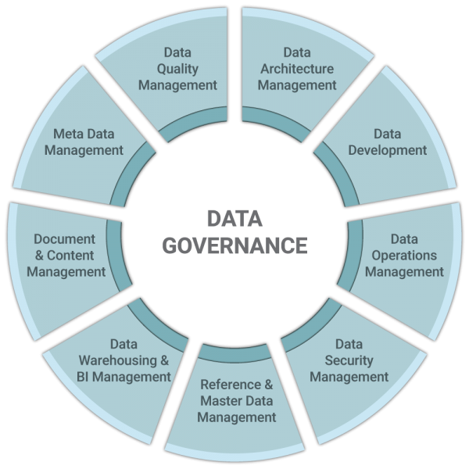
Definitions cont.
Data governance is, “the discipline which provides all data management practices with the necessary structure, strategy, and support needed to ensure that data are managed and used as a critical asset.” (Office of the Provost, 2022)
The purpose of data governance is to better understand how valuable data is to an organizations decisions.
(Ascention, n.d)
Notes:
- Many different factors of data governance
- Data governance includes the security of the data, preventing it from being used by unwanted personnel.

Slide 4
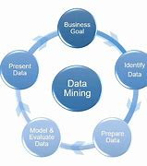
Data Mining
Data mining is the process of extracting large sets of data and uncovering patters with the use of artifical intelligence.
The goal of data mining is to use machine learning, automated tools, to discover useful information instead of by a data analyst.
According to IBM, machine learning can, “organize and filter data, surfacing the most interesting information, from fraud detection to user behaviors, bottlenecks, and even security breaches.” (IBM Cloud Education, 2021)
Many benefits to data mining. It has improved decision-making within an organization and can predict outcomes for an organization’s future.
However there are still challenges when implemening data mining, involving scalability, privacy and security.
(Terkhedkar, 2019)
Notes:
- A dataset with thousands of rows can be read by automated technology
- Artificial intelligence can be used make crucial, accurate decisions based on their knowledge of the data.
- May unecessarily present personally identifiable information without permission from the consumer.

Slide 5
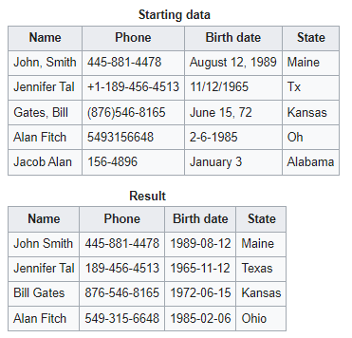
Data Wrangling
Data wrangling is the process of transforming raw data into an acceptable, consistent format.
The purpose of data wrangling is to increase the quality of the data, turning “messy” data into readable organized data.
On the top chart, you would notice that the phone number, birthdate, and states are not formatted in the same way.
On the bottom chart, wrangling is performed and the data is now formatted, with all of the phone numbers being presented in a certain way, {area code-XXX-XXXX} and the dates being {YYYY-mm-dd}.
To recap, data mining finds patterns while data wrangling delivers insights, both using the same automated tools.
Notes:
- Example: (876)546-8165 vs. 5493156648 or August 12, 1989 vs. 11/12/65

Slide 6
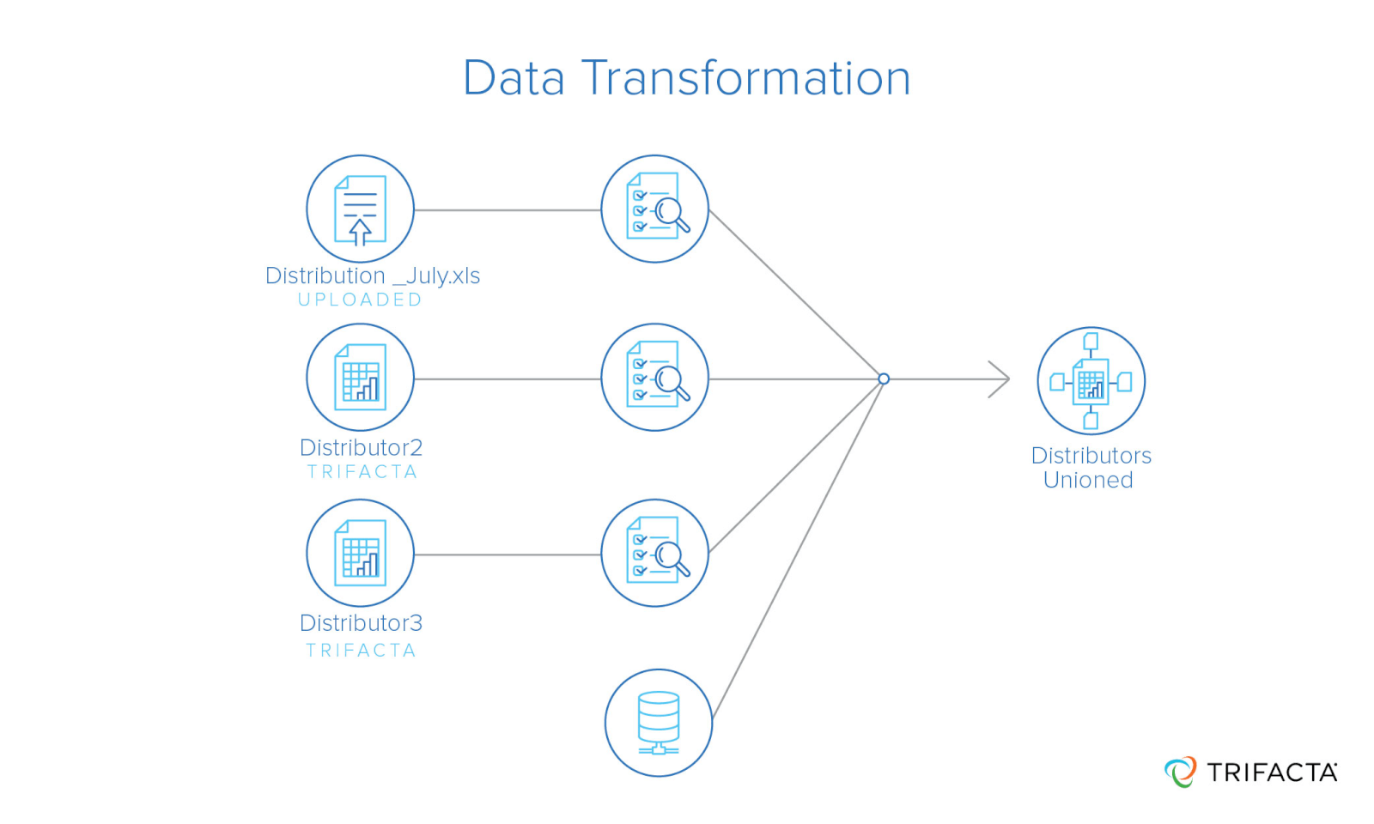
Data Transforming
Data transformation is the processes of converting a dataset into a different format for analysis or storage purposes.
Unlike data mining, data transformation can be performed by organizations to make data compatible for better analysis, to move data from physical locations to the cloud, or maybe they want to consolidate structured and unstructured data.
When transforming data, it can be time-consuming and costly.
(“Data Transformation”, n.d)
Notes:
- Data needs to be cleaned before it can be transformed, which can take hours
- Very costly, organizations are investing in software, tools, and are hiring new employees to perform this task

Slide 7
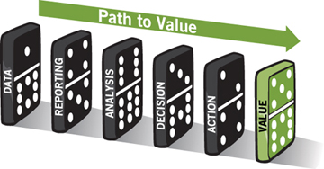
Reporting vs. Analysis
Reporting is the process of translating data collected into information to montior performance throughout parts of a business, while Analysis extracts meaningful information to improve performance.
The purpose of Reporting is used as a way to monitor data, making meaningful decisions when data falls below an expected range.
When conducting analysis, we question how much collected data we can use to make crucial decisions and finding answers.
(Adobe Press, 2011)
Notes:
- Reporting is figuring out what is happening vs. Analysis, figuring out why its happning

Slide 8
Conducting Data Analysis and How it Helps Leadership in the Decision-Making Process.
Conducting data analysis helps the decisions-making process in many different ways.
As described by Ohio University, “Analyzing data is the process of retrieving original data using specialized computer systems and applications. This original data is transformed into different formats or classifications of meaningful information that supports decision-making.” (”Data Analysis for Decision making”, n.d.)
We can create statistical visuals, showing financial numbers from previous years or months, and make a prediction on growth.
Without data analytics, the ability to make crucial decisions will be based on viewing thousands of rows of data over a long period of time, taking days instead of hours to make a decision that could serious affect the future of a company.
This is in comparison to conducting data analytics and making a decision within the same day,
Notes:
- Bar graphs, line graphs, or other graphs you would typically see during a company presentation
- Dashboards
- Suppose the company is losing money (bankrupcy) and they need a way to cut costs. They can make a decision within the same day using data analysis instead of viewing the thousand or more rows of data collected, which is time consuming and would last days.

Slide 9
References
Data Analysis for Decision making. Ohio University. (2020, February 3). Retrieved December 8, 2022, from https://onlinemasters.ohio.edu/blog/a-step-in-the-right-direction-data-analysis-for-decision-making/
Frankenfield, J. (2022, September 21). Data analytics: What it is, how it's used, and 4 basic techniques. Investopedia. Retrieved December 8, 2022, from https://www.investopedia.com/terms/d/data-analytics.asp#:
IBM Cloud Education. (2021, January 15). What is data mining? IBM. Retrieved December 8, 2022, from https://www.ibm.com/cloud/learn/data-mining
Office of the Provost. (2022, April 29). Definitions: Data governance and Data Domains - University of Rochester. Office of the Provost. Retrieved December 8, 2022, from https://www.rochester.edu/provost/university-data/data-governance-overview/what-is-data-governance/
Responsible Conduct in Data Management. Data Analysis. (n.d.). Retrieved December 8, 2022, from https://www.niu.edu/rcrportal/datamanagement/datopic.html

Slide 10
Photos
Adobe Press. (2011). If you remove one of these dominoes, you won't be able to achieve the desired value. Web Analytics Action Hero: On the Road to Actionland. photograph. Retrieved December 8, 2022, from https://www.adobepress.com/articles/article.asp?p=1811387&amp;seqNum=3.
Ascention. (n.d.). Data Governance – the yardstick for excellence in data. photograph. Retrieved December 8, 2022, from https://ascention.com/data-management/data-governance/.
Data Transformation. (n.d.). photograph.
Terkhedkar, T. (2019). What is data mining? DATA MINING TECHNIQUES. photograph. Retrieved December 8, 2022, from https://medium.com/@tanmayct/data-mining-techniques-24d01a8fb71e.

